Slide 1
Final Team 5 Project Big Data for Business Professor – Dr. Kaushik Dutta Spring, 2023
Francisco Reyes
Charles Wells
Sanaa Wehse
Anri Ferris
Lloyd McGehan

Slide 2
Agenda
Project purpose
Components used
Data flow model (Excel, Databricks)
Source code (PySpark)
Results/Solution
Challenges
Links
Code on GitHub repository (submit the link on Canvas); Be sure to click the -- Green Code -- button to download the zip file: https://github.com/cwells9180/usf6562_bigdata_group5

Slide 3
Project Purpose
Our team’s objective was to analyze and predict the price of an Airbnb dwelling, using a dataset (see Github link) provided by Dr. Varol Kayhan during a previous Data Science Programming class, part of the Global BAIS program at USF.
The purpose of the exercise is to predict a dwelling (i.e., condo, townhouse, timeshare,…) price using a decision tree model and categorical values.

Slide 4
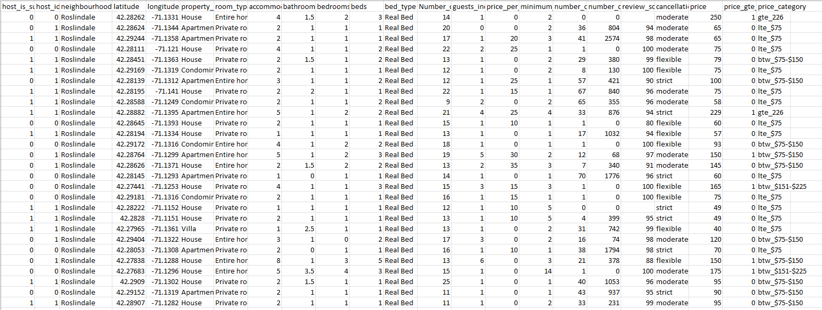
Input Components Used
Excel file which was uploaded into Databricks
Created Jupyter Notebooks using HDFS on Databricks Community Edition
Dataset inputs/variables included Longitude and Latitude for location, number of bedrooms, Neighborhood, Host Identity Verified, Room Type, Property Type, Number of Reviews, Cancellation,….
Inputs = mix of numerical and string values

Slide 5
Design Models
KMeans
Decision Tree Classifier
Super Vector Machine (SVM)
Output = categorical variable for price category

Slide 6
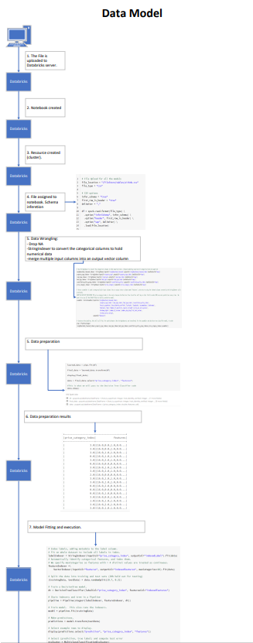
Data Model
Please open the attached drawing in PDF for the Data Model

Slide 7
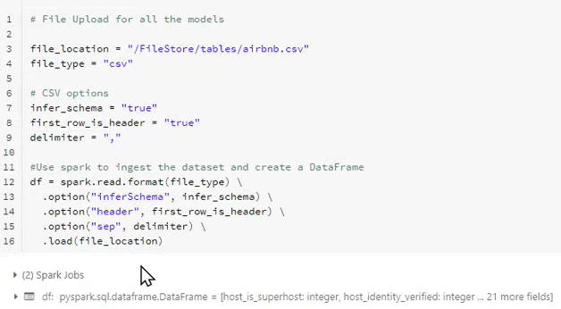

Dataset (new)
Used Spark to ingest the dataset and remove null values from the dataset

Slide 8
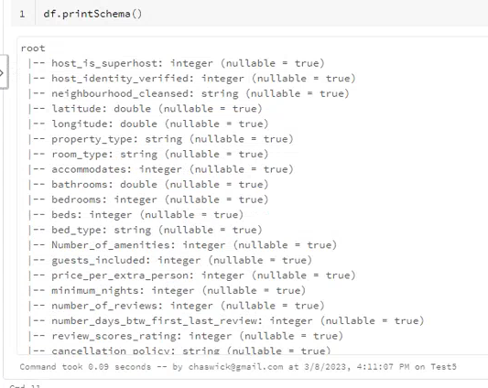
Printed the Output Schema

Slide 9
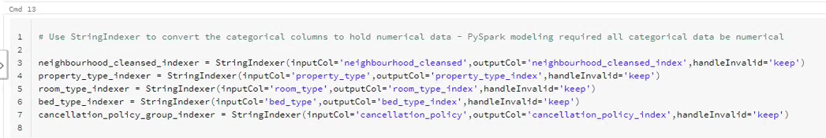
Converted Categorical to Numerical Values
The most frequent value in the dataframe received the lowest value index. For instance, if the most frequent number of bedrooms is 3, 3 bedrooms was assigned a value of 0.

Slide 10
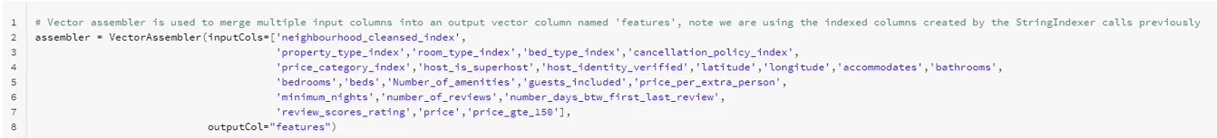
List of Pre-Processed Values/Features Using the Vector Assembler
Set-up a pipeline to pass the dataset through the indexer and assembler

Slide 11
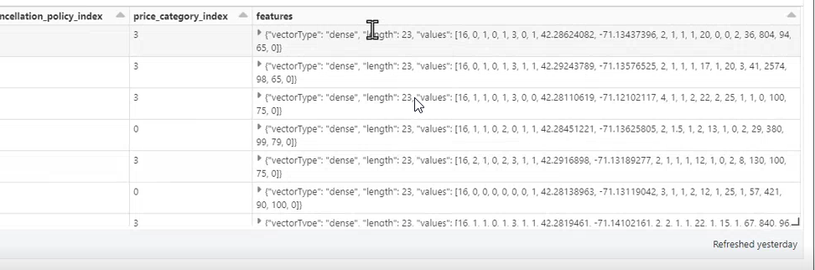
Data Preparation
String Indexer implements Fit and Vector Assembler implements Transform and both work together to combine Columns/Features in the Vector Assembler

Slide 12

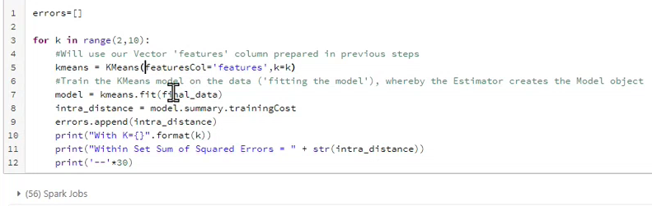
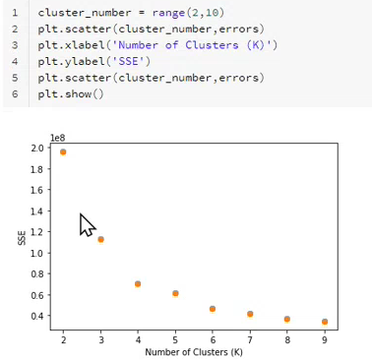
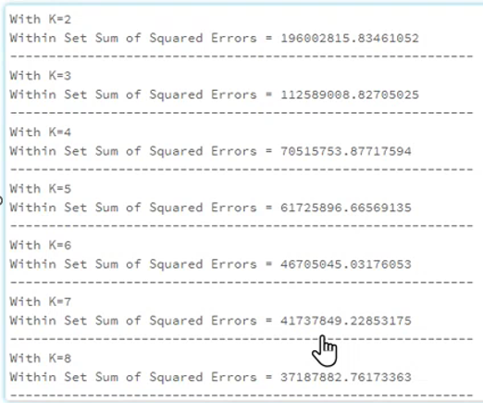

Built K-Means Model to Determine No of Clusters = 5
Looking at the plot we used the Elbow method to determine K = 5

Slide 13

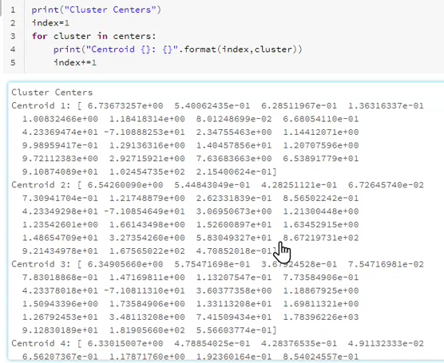


Trained the Kmeans Model
Printed the Model Fit Using KMeans = 5

Slide 14
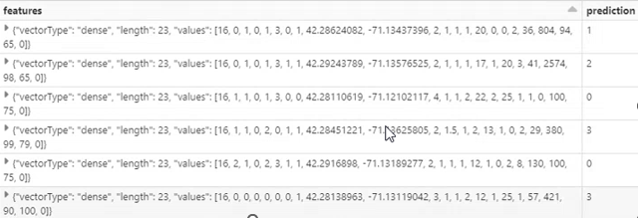
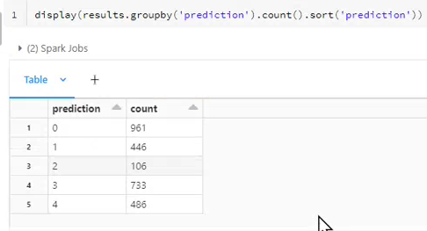
Predicted the Features
The features in the left column provide us with the predicted cluster
Displayed Cluster Summary
Notes:
We can see that cluster 1 has 446 elements, cluster 2 has 106 elements, etc…

Slide 15
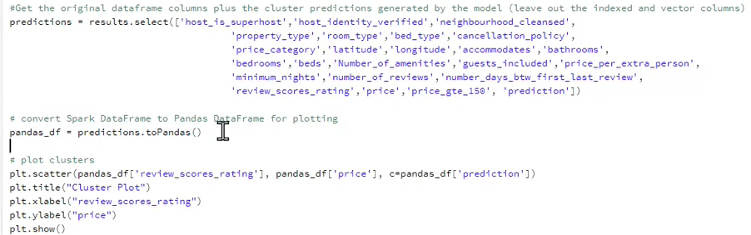
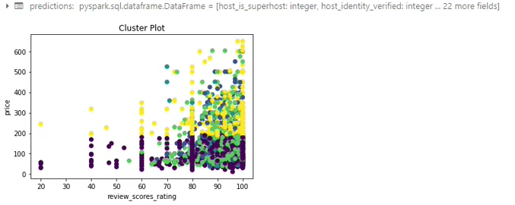
Plotted the Classifications using Pandas
Used all variables to classify the model
Example:
Presented cluster plot showing 2 variables (Price Point/Review Score) to classify all data points
Yellow cluster is > $200 price point
Green is > score rating of 60
Purple is < $200 price point

Slide 16
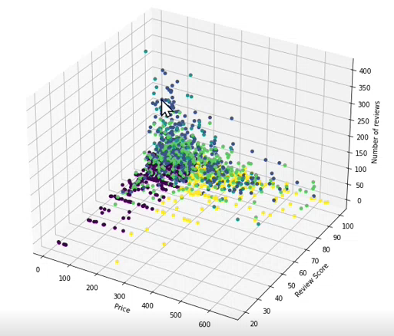


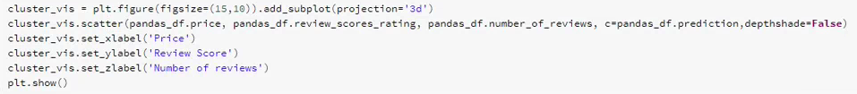
Plotted the KMeans Cluster in 3D View
The yellow cluster does not seem to have a high number of Reviews, while having a high Price and a high Review Score.

Slide 17
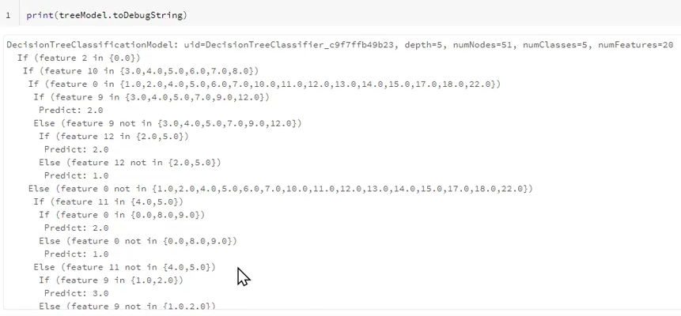
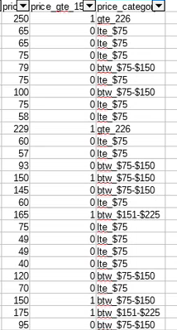
Decision Tree Classifier Model to Predict Price Category
Actual Price Categories

Slide 18
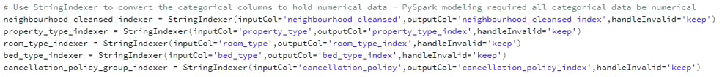
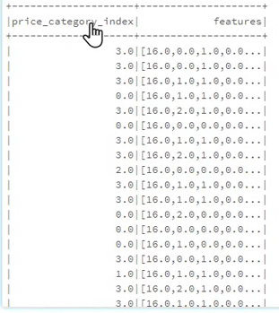
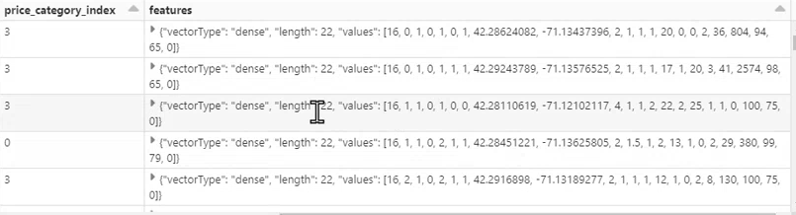
Passed Price Category Index Values

Slide 19
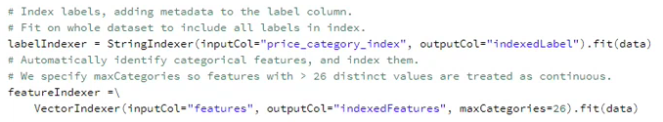
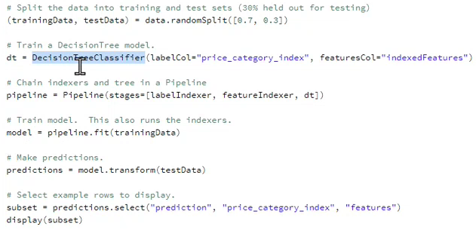
Set Train/Test Split
Selected the data features
Set train/test split 70/30 & run the predictions

Slide 20
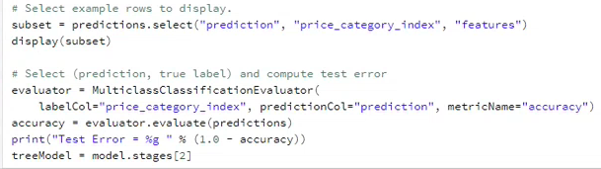
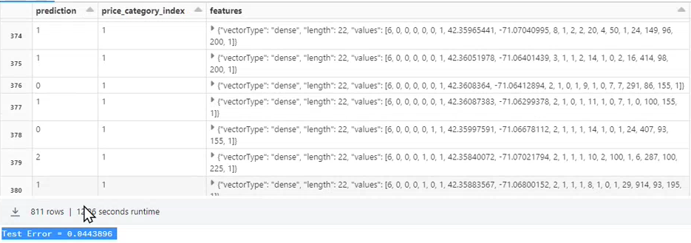
Computed the Test Error
Measured how well the model predicts the price category. .46 error for the Test group is pretty low. We will need to perform additional analysis to improve the model performance in a subsequent study.

Slide 21
Decision Tree Output

Slide 22
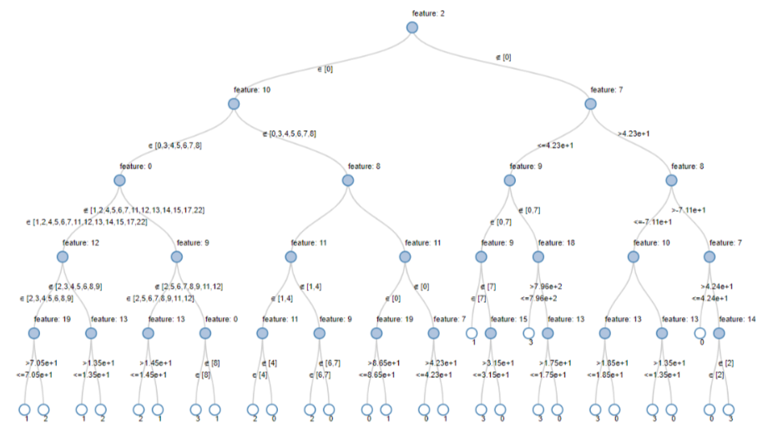
Decision Tree Output

Slide 23
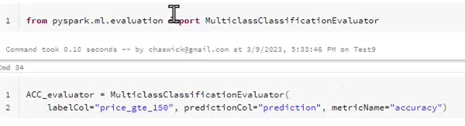



Area Under the Curve and Accuracy
We have concerns about the high AUC of .92, considering our test error of .46.
Area Under the Curve = .92
Accuracy (Good) = .92 (Good high accuracy of the model)

Slide 24
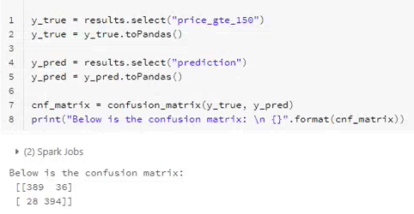
Confusion Matrix
The model is pretty good at predicting the true values as indicated in the Confusion Matrix
True Positive False Negative
False Positive True Negative

Slide 25
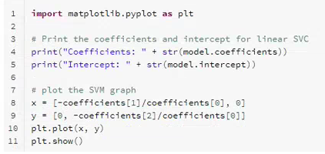
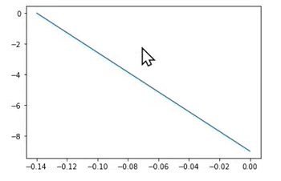
Plotted the Super Vector Machine Model
Plotted the line that best splits the values
Below are the Intercept and the betas for the SVM
Notes:
1:06 mins

Slide 26
Decision Tree Output Interpretation
DecisionTreeClassificationModel: uid=DecisionTreeClassifier_c9f7ffb49b23, depth=5, numNodes=51, numClasses=5, numFeatures=20
If (feature 2 in {0.0})
Else (feature 2 not in {0.0})
Else (feature 7 > 42.327788625)
Predict: 3.0
Feature 2 = Neighborhood
Feature 7 = Latitude
Conclusion:
The model is predicting based on Neighborhood and Longitude, which aligns with Real Estate practices.

Slide 27
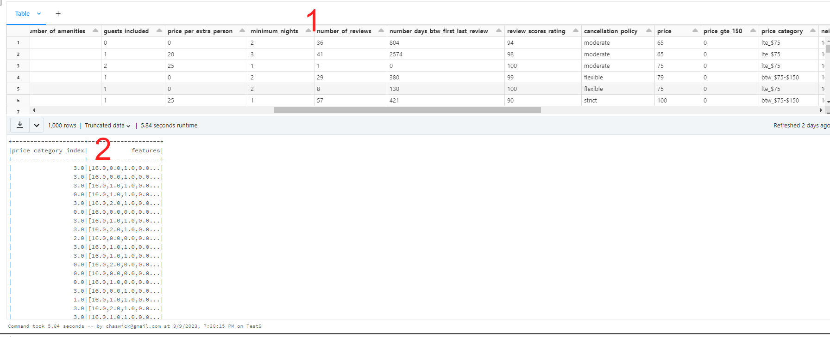
Challenges and Lessons Learned
Understanding how data preparation is separated from model building: even though they both use the .fit() / .transform() interfaces (1 is the data prep including string indexers), 2 represents just the input necessary for the model

Slide 28
Challenges and Lessons Learned cont’d
Initially we included Price Category and other Price related columns as inputs.
Test Accuracy = 1? Perfect prediction with no error?
For the SVC and Decision Tree models, Realized that the input vector feature must not include columns which perfectly or strongly correlate to the category used in the label column
Removing all references to price yielded a model that predicted using geographic location
We also realized this means that by finetuning the subset of input vectors we can restrict the model in different ways, perhaps increasing our understanding of the data without needing another dataset

Slide 29
THANK YOU

Slide 30
APPENDIX

Slide 31
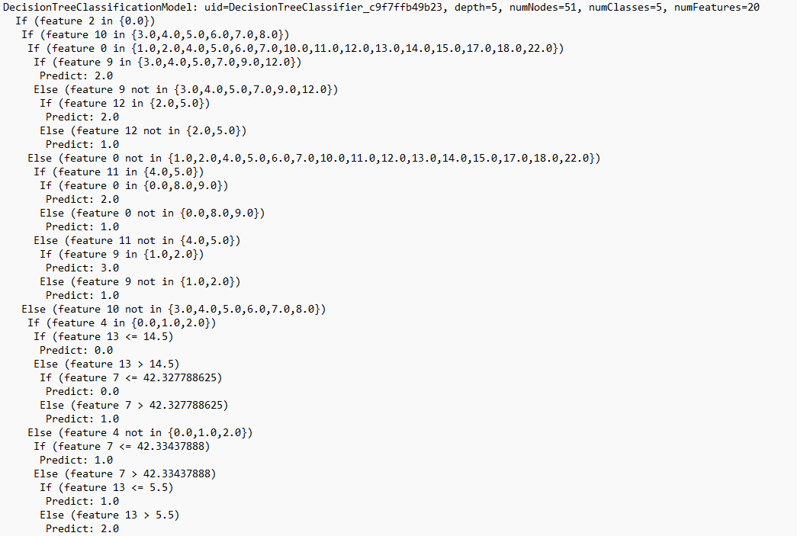
Decision Tree

Slide 32
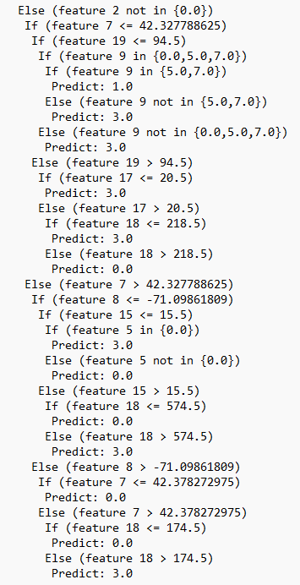
Decision Tree (continued)

